Slide 1
VR150 German Culture FALL 2021
German School System and Abitur
Yaokun Ji 季耀坤

Slide 2
Content
Nomenclature: Deutsch for special Germany words; English for special English words
3-element school system (Hauptschule, Realschule, Gymnasium) and Abitur
Vocational training (Lehre)
Current ideas towards the education system

Slide 3
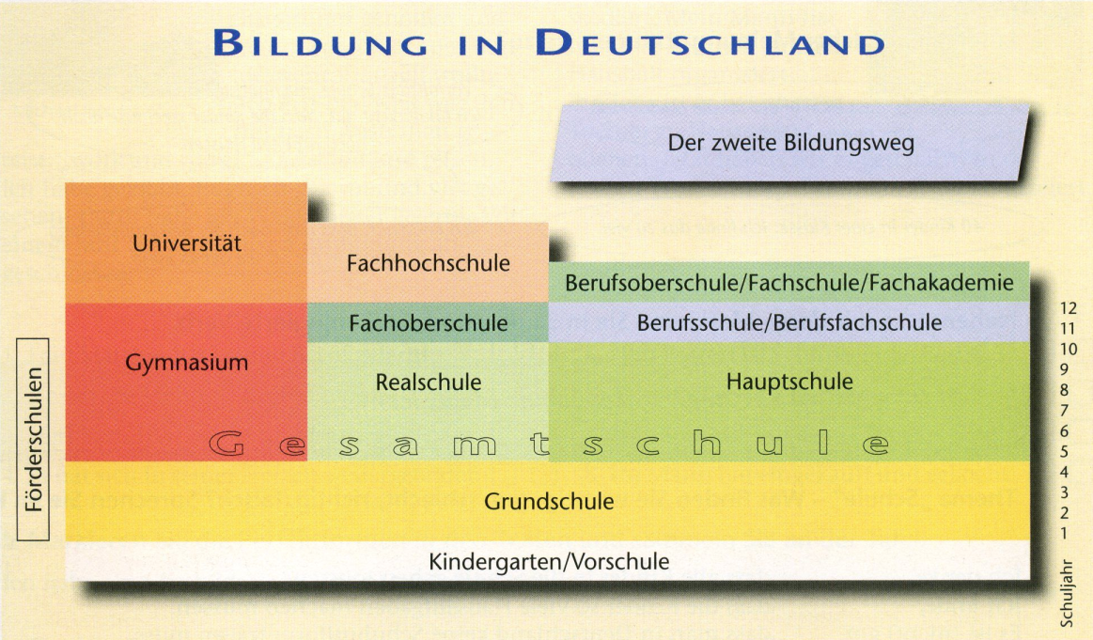
Overview [1]

Slide 4
Overview [1]
Education
The second path of education
Academic
Practical
General
Special Schools
Secondary School
School Year
Primary School
Comprehensive School
Kindergarten
Notes:
P45, Berliner Platz
Complexity: after WWII, Germany divided and governed by different countries; setting various education systems in different places
Education in Germany is primarily the responsibility of individual German states (Länder), with the federal government playing a minor role. Optional Kindergarten (nursery school) education is provided for all children between one and six years old, after which school attendance is compulsory.
Grammar School

Slide 5
Overview [1]
(Abendschulen)
Abitur
12th,13th grade
10th grade
9th,10th grade
for 4 or 6 years
Age 5 or 6
Notes:
Berlin and Brandenburg: 6 years Grundschule
Go to school for at least 9 years (Schulpflicht), ending after an end of graduation test or after 18 years old
Abitur / Realschulabschluss / Hauptschulabschuluss

Slide 6
Overview [1]
>
>
Notes:
Gesamtschule: offers an alternative apart from the three-element school system
In the face of criticism of the purported divisions it creates, some federal states have abolished the streamed school system in favour of schools that combine two or three different models to offer multiple kinds of qualifications.
Transformable (from other secondary schools to Gymnasium and vise versa)

Slide 7
Policies from Government [2]
Grundschule (primary school): Normally, six-year-olds begin their school careers at primary school, which covers the first four grades. Only in Berlin and Brandenburg does primary school continue to the sixth grade. At the end of primary school, you and your child's teachers will decide, depending on your child's performance, which secondary school your child will attend.
Weiterführende Schulen (secondary schools) - the most common types are:
Hauptschule (secondary general school for grades five through nine or ten)
Realschule (more practical secondary school for grades five through ten)
Gymnasium (more academic secondary school for grades five through twelve/thirteen)
Gesamtschule (comprehensive school for grades five through twelve/thirteen)

Slide 8
Policies from Government [2]
Hauptschule and Realschule: Young people who have successfully completed the Hauptschule or Realschule are eligible for vocational training, or can transfer to the sixth form / senior high at a Gymnasium or Gesamtschule.
Gesamtschule: Combines the Hauptschule, Realschule and Gymnasium and offers an alternative to the tripartite school system.
Gymnasium: At the end of the 12th or 13th grade, students take examinations known as the Abitur and if successful graduate from high school with a certificate of advanced secondary education entitling them to study at a university or at a university of applied sciences. However, they may also choose to undergo vocational training and enter the job market directly.

Slide 9
Gymnasium [3]
Selective schools with quality education
Preparation for college study
Curriculum: various courses (German, Math, Physics,…),
and required to study at lease two foreign languages
Notes:
German gymnasiums are selective schools. They offer the most academically promising youngsters a quality education that is free in all state-run schools (and generally not above €50/month cost in Church-run schools, though there are some expensive private schools). Gymnasiums may expel students who academically under-perform their classmates or behave in a way that is often seen as undesirable and unacceptable.
Pupils study subjects such as German, mathematics, physics, chemistry, geography, biology, arts, music, physical education, religion, history and civics/citizenship/social sciences and computer science. They are also required to study at least two foreign languages.

Slide 10
Realschule [4]
Ranked between Hauptschule and Gymnasium
Extended education and at least learning one foreign language
After completion: can attend Gymnasium / Berufsschule / Apprenticeship
Notes:
In the German secondary school system, Realschule is ranked between Hauptschule (lowest) and Gymnasium (highest). At Realschule, a student gets an extended education and learns at least one foreign language, usually English. After completing the Realschule, good students are allowed to attend a professional Gymnasium or a general-education Gymnasium. They can also attend a Berufsschule or do an apprenticeship.
Go back

Slide 11
Lehre [5]
Lehre (vocational training, apprentice)
Extended education: business subjects in addition to academic curriculum, from grade five to ten
Diploma (Realschulabschluss / mittlere Reife): students can enter a business or technical school, or attend training in companies (eine Ausbildung im Betrieb machen)

Slide 12
Hauptschule [6]
Poor students
Similar subjects with Realschule and Gymnasium, but much slower
Featuring “work study (Arbeitslehre)”; practical skills more important than academic skills; also can qualify for Realschule and Gymnasium with good scores
Notes:
The main aim of Hauptschulen is to offer young students with average grades or below, most of whom will not attend a university, an adequate general academic education. They largely teach the same subjects as a Realschule or Gymnasium, but at a slower pace.
Once students have obtained their graduate certificate at the age of 15–16, they can go into practical vocational training, start work in the public service at basic or secretarial level, or attend a Berufsfachschule (full-time vocational school). The jobs for which they apply consequently require practical skills rather than academic knowledge. They may also qualify for further education in a Realschule or Gymnasium if their marks are good enough.

Slide 13
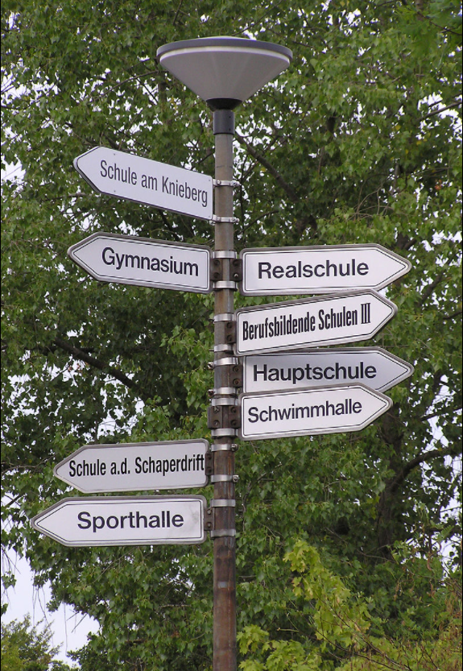
Choice of Secondary Schools [2]
Gymnasium: more academical; good grades and performance
Realschule and Hauptschule: more practical (career)
Gesamtschule: comprehensive

Slide 14
Choice of Secondary Schools [2]
Orientation/Testing Phase in grades five and six, embedded in secondary school system (Berlin and Brandenburg: embedded in primary school)
Teachers: recommendation based on main-subjects (Math, German, Natural Sciences, Foreign Languages) performance and school behavior (immaterial)
Admission: different from state to state
(Berlin: Gymnasium, 30-35%, lottery)
(Some other states: anyone can apply)
Notes:
Grades 5 and 6 form an orientation or testing phase (Orientierungs- or Erprobungsstufe) during which students, their parents and teachers decide which paths the students should follow, embedded into secondary school system. The decision for a secondary school influences the student's future, but during this phase changes can be made more easily. [In Berlin and Brandenburg, the orientation is embedded into that of the elementary schools.] Teachers give a so-called educational path recommendation based on scholastic achievements in the main subjects (mathematics, German, natural sciences, foreign language) and immaterial classroom behavior with details and legal implications differing from state to state. In Berlin 30% – 35% of Gymnasium places are allocated by lottery.

Slide 15
Abitur [7]
Abitur/Abi: certificate of general qualification for university entrance (Zeugnis der Allgemeinen Hochschulreie)
Mainly three aspects:
Language, literature and the arts
Social sciences
Mathematics, natural sciences and technology
(Sports)

Slide 16
Abitur [7]
During final exams (Abiturprüfungen): tested in 4 or 5 subjects, at least one oral
Grades: from 1.0 (best) to 4.0 (worst)
In school courses:
1=sehr gut, 2=gut, 3=befriedigend, 4=ausreichend, 5=mangelhaft, 6 = ungenügend
Course | Type of examination
1st advanced course | Written
2nd advanced course | Written
3rd advanced course | Written
Basic course | Oral
Basic course | Oral, presentation or exceptional learning achievement (20-pg paper)
Pass Line
Notes:
3 = satisfactory; 4 = adequate; 5,6 fail

Slide 17
Scoring of Abitur [7]
The exact scoring system depends on the Bundesland, in which one takes Abitur. Passing the Abitur usually requires a composite score of at least 50%. Students with a score below that minimum fail and do not receive an Abitur.
There are some other conditions that the student also has to meet in order to receive the Abitur: taking mandatory courses in selected subject areas, and limits to the number of failing grades in core subjects.
Finally, students often have the option of omitting some courses from their composite score if they have taken more courses than the minimum required.

Slide 18
Calculation of Scores [7 11]
Weighted aptitude assessment: Abitur + school grades
School grades: “Each semester of a subject studied in the final two years yields up to 15 points for a student, where advanced courses count double. The final examinations each count quadruple.” → 15 points, 4 semesters in total for each counted subject
Abitur: usually in total 900 points, where ≥823 get 1.0

Slide 19
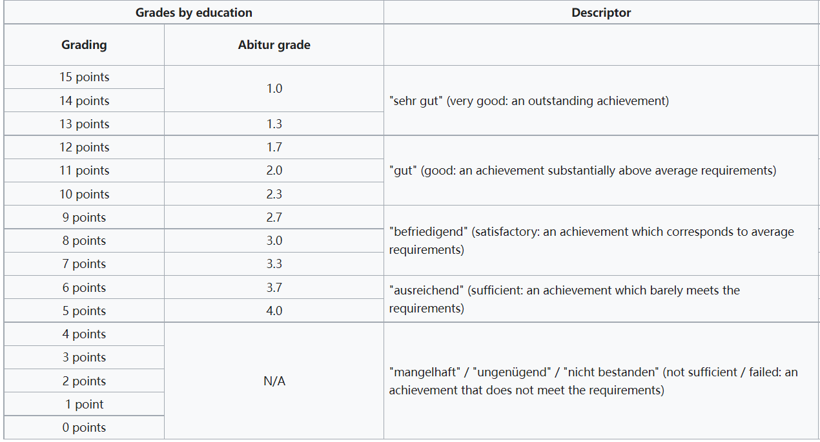
Grades of Abitur [7]

Slide 20
Example of Georg-August-Universität Göttingen [11]
A tester gets 833 out of 900 in Abitur and his core grades for his counted subjects are:
Math: 14 14 13 13 (main course)
German: 14 15 13 14
English: 10 11 12 12
Abitur: 1.0 grade and average school scores:
Maths 13.50; German: 14.00; English: 11.25

Slide 21
Example of Georg-August-Universität Göttingen [11]
Then his total grades for ranking of each applicant in the order of qualification, with weight 80%+10%+5%+5%:
Abitur out of 15 scores 833÷60 = 13.88 (no rounding up, the last decimal places are ignored);
Abitur = 13.88×0.8 = 11.104
Maths = 13.50×0.1 = 1.350
German = 14.00×0.05 = 0.700
English = 11.25×0.05 = 0.562(5)
Total = 11.104+1.350+0.700+0.562(5) = 13.71 points

Slide 22
Discussion of Secondary School System
German study finds link between social background, educational success [8]:
The children of teachers, doctors and researchers are much more likely to pursue an academic career than children from so-called "educationally disadvantaged" backgrounds, where reading, musical study or museum visits aren't part of family life.
And in the German states of Bavaria, Baden-Württemberg, Lower Saxony and Schleswig-Holstein, children of academic families are six times more likely to finish high school than children from a lower social class; in Berlin, Hamburg, Hesse and Saxony, this figure drops to 2.5 percent. These results are found in the latest report from the German think tank Bertelsmann-Stiftung and the Institute for Research in Education Development in Dortmund.

Slide 23
Discussion of Secondary School System
Education researcher Wolff-Dietrich Webler, a professor at Norway's University of Bergen, says these differences can be attributed to the fact that the German education system is tied to social class. Webler, who has also studied the issue, says children from educated middle-class families tend to encounter material in school that is already familiar to them from exposure at home.
"Children from other [lower] social classes are much less likely to find their values and way of life represented at school," said Webler, speaking with DW.

Slide 24
Discussion of Secondary School System
A UN's Special Rapporteur: warned of the dangers of social exclusion resulting from the system. Children from low income backgrounds, children of immigrants and disabled children are especially at a disadvantage. [9]
Several measures were taken to relax the system. These reforms included delaying the age when children are assigned to different secondary schools, combining Realschulen and Hauptschule, and introducing more comprehensive schools. [10]

Slide 25
Reference
[1] “Schule und danach”, Berliner Platz 2 Lehrerbuch, Page 45
[2] “Germany's school system”, official website of The Federal Government of Germany - Make it in Germany
[3] “Gymnasium”, Wikipedia, https://en.wikipedia.org/wiki/Gymnasium_(school)#Germany
[4] “Realschule”, Wikipedia,
https://en.wikipedia.org/wiki/Realschule
[5] “Wie geht’s”, Google, 2011: Page 337
[6] “Hauptschule”, Wikipedia, https://en.wikipedia.org/wiki/Hauptschule#Basics
[7] “Abitur”, Wikipedia, https://en.wikipedia.org/wiki/Abitur
[8] “German study finds link between social background, educational success”, Web, https://www.dw.com/en/german-study-finds-link-between-social-background- educational-success/a-15805347

Slide 26
Reference
[9] “'Germany's School System Is an Anachronism’”, Web, https://www.spiegel.de/international/germany/the-world-from-berlin-germany-s- school-system-is-an-anachronism-a-473337.html
[10] “What can we learn from the great German school turnaround”, Web,
https://www.theguardian.com/teacher-network/2015/nov/25/what-can-we-learn- from-the-great-german-school-turnaround
[11] “Calculation examples for the weighted aptitude assessment procedure”,
https://www.uni+goettingen.de/en/calculation+examples+for+the+weighted+aptitud e+assessment+procedure/47865.html

